Slide 1
Scheduler: In Order Issue – Out of Order Execution
Fetch Logic
PC
IF
Instruction Decoder
imm gen
ID
EX
LSU
ALU
commit
Branch Prediction
Int
Register File
FP
Register File
WB
MUL/DIV
Scoreboard/Aligner
FPU
Instruction memory/Cache(FIFO)
Reorder Buffer (ROB)
issue
Branch Unit
Scoreboard
LSU
Address
Branch Logic
Control Unit – Interrupt Handler – Debug Interface

Slide 2
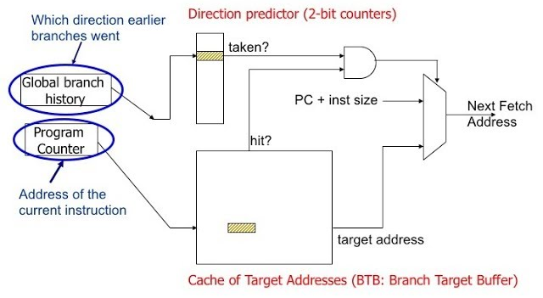
2 bit Dynamic Branch Prediction:
Strongly not Taken شبیه
Taken
Weakly not Taken شبیه
Taken
Weakly not Taken شبیه
Taken
Strongly
Taken شبیه
Not Taken
Taken
Not Taken
Not Taken
Not Taken
Branch Target Buffer (BTB)
Branch Target Address (BTA)

Slide 3
Fetch and Prefetch Logic:
imm gen
immediate
Instruction queue (buffer)
L1/L2 cache
PC
+
Next PC
PC
+ 4
Instruction Fetch
PC
Branch Signal
32’hFFFC
Reset Signal

Slide 4
Fetch Directed Architecture:
Prefetch Instruction Queue
Instruction queue (buffer)
L1/L2 cache
L2 Cache Prefetch
Branch Predictor
Prefetch Filtration Mechanism
Prefetch
Buffer
Instruction Fetch
Fetch Target Buffer
Instruction Fetch
Fetch Target Queue

Slide 5
Register File Structure:
5
Read_index_1
Register File
reg [31:0] REGS [31:0];
32
Read_Data_1
5
Read_index_2
5
32
Write_index_2
Read_Data_2
32
Write_Data
CLK
Read_1_Enable
Write_Enable
Read_2_Enable

Slide 6
Arithmetic and Processing Units:
funct3
funct3
funct7
funct7
opcode
opcode
32
32
RS1
Operand_1
ALU
Operand_1
MUL
32
32
ALU_output
MUL_output
RS2
32
32
Operand_2
Operand_2
imm
R_TYPE

Slide 7
Arithmetic and Processing Units:
opcode
Operand_1
LSU
Reg_to_Mem
Mem_to_Reg
address
RS1
+
imm
Data Memory

Slide 8
Branch Unit:
opcode
B_TYPE (Enable)
Committing will happen in Branch Logic
RS1
If (RS1 == RS2)
If (RS1 > RS2)
If (RS1 < RS2)
Branch_Condition
RS2

Slide 9
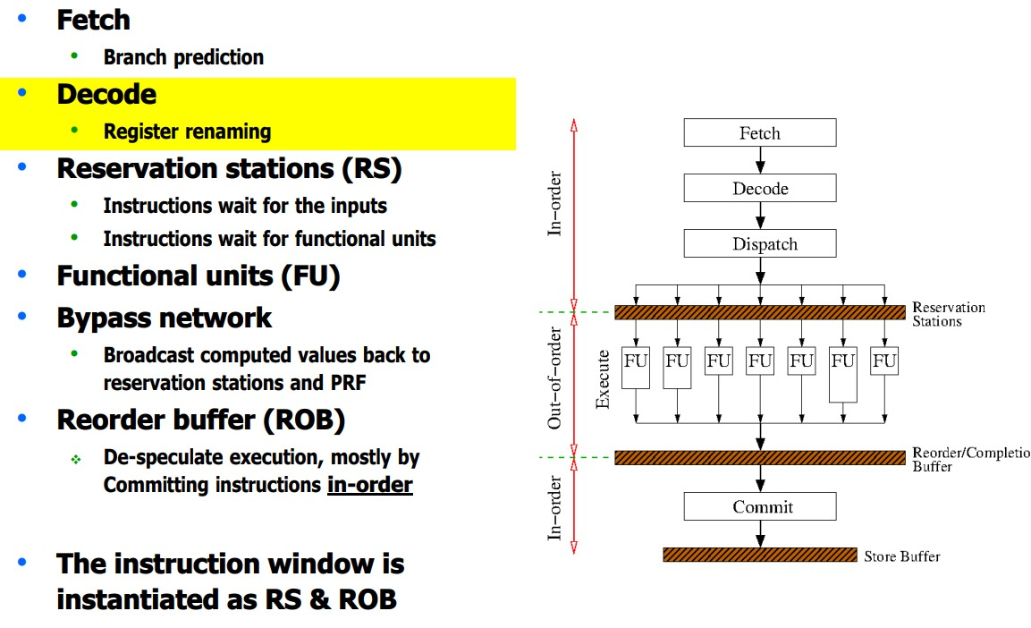
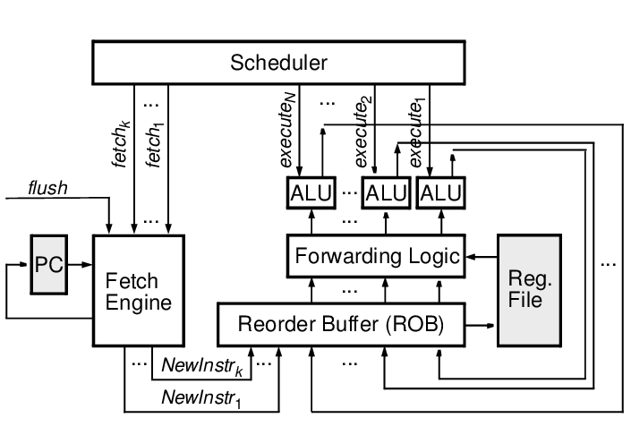
OoO Execution:

